Slide 1
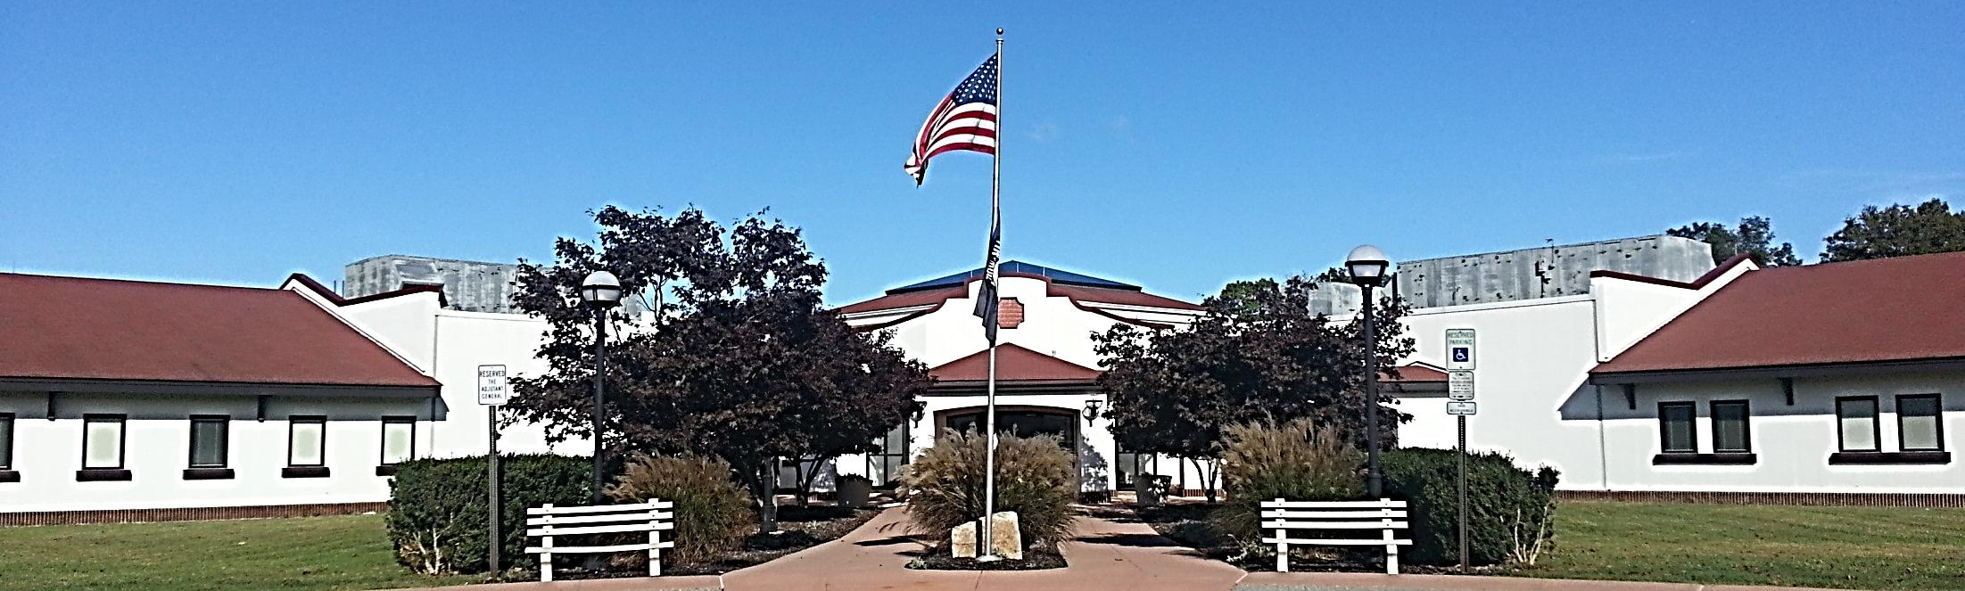
Veteran’s Haven
New Jersey Department of Military and Veterans Affairs
TRANSITIONAL HOUSING PROGRAMS FOR HOMELESS VETERANS

Slide 2
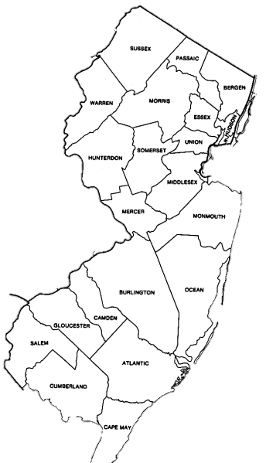
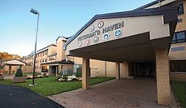
2 Facilities
TRANSITIONAL HOUSING PROGRAMS FOR HOMELESS VETERANS
Veteran’s Haven North
New Jersey Department of Military and Veterans Affairs
“The Rally Point”
Veteran’s Haven South
New Jersey Department of Military and Veterans Affairs
“Base Piece”
Located in Winslow, NJ
Camden County
PO Box 80
301 Spring Garden Road
Winslow, NJ 08095
Phone: 609-561-0269
Phone: 609-567-5806
Toll Free: 888-849-7188
Located in Glen Gardner, NJ
Hunterdon County
200 Sanatorium Road, Suite 101
Glen Gardner, NJ 08826
Phone: 908-537-1999
Toll Free: 877-648-0091
100 Bed Capacity in Each

Slide 3
Our Goal
New Jersey Department of Military and Veterans Affairs
Veteran’s Haven North
New Jersey Department of Military and Veterans Affairs
“The Rally Point”
Veteran’s Haven South
New Jersey Department of Military and Veterans Affairs
“Base Piece”
To ensure that homeless veterans are treated and cared for in a dignified, compassionate, and professional manner so as to reach an optimal level of independence and aid them in re-acquiring the life skills and ability to live in the community while maintaining their self-sufficiency, dignity, and honor.

Slide 4
Veteran’s Haven
New Jersey Department of Military and Veterans Affairs
Veteran’s Haven North
New Jersey Department of Military and Veterans Affairs
“The Rally Point”
Veteran’s Haven South
New Jersey Department of Military and Veterans Affairs
“Base Piece”
The Team
A diverse team of professionals specializing in social services, psychosocial rehabilitation, addictions, vocational rehabilitation, and nursing.
Services ISP- Individual Service Plan Holistic Case Management HMIS-Homeless Management Information System | Partnerships Veterans Affairs New Jersey State Parole Board Continuum of Care Members in Surrounding Counties Various Community Agencies and Associations Various Veterans Service Organizations

Slide 5
Programs
New Jersey Department of Military and Veterans Affairs
Veteran’s Haven North
New Jersey Department of Military and Veterans Affairs
“The Rally Point”
Veteran’s Haven South
New Jersey Department of Military and Veterans Affairs
“Base Piece”
Transitional Housing Program
2 year program
Admission criteria
S.H.I.E.L.D Program
Supportive Housing in Early Living Development
-Emergency Contract Housing through the VA
Referred strictly through VISN III
90 day stabilization program
Transitional Housing Program
2 year program
Admission criteria

Slide 6
Veteran’s Haven
New Jersey Department of Military and Veterans Affairs
Veteran’s Haven North
New Jersey Department of Military and Veterans Affairs
“The Rally Point”
Veteran’s Haven South
New Jersey Department of Military and Veterans Affairs
“Base Piece”
Served Military Service Era
January 1, 2016 – December 31, 2016
TOTAL SERVED- 378 Veterans

Slide 7
Veteran’s Haven
New Jersey Department of Military and Veterans Affairs
Veteran’s Haven North
New Jersey Department of Military and Veterans Affairs
“The Rally Point”
YTD % of Successful Discharges: 84.6%

Slide 8
Veteran’s Haven
New Jersey Department of Military and Veterans Affairs
Veteran’s Haven South
New Jersey Department of Military and Veterans Affairs
“Base Piece”
YTD % of Successful Discharges: 84.0%

Slide 9
Veteran’s Haven
New Jersey Department of Military and Veterans Affairs
Veteran’s Haven North
New Jersey Department of Military and Veterans Affairs
“The Rally Point”
Veteran’s Haven South
New Jersey Department of Military and Veterans Affairs
“Base Piece”
Thank You

